Slide 1
CIDM 6312 – Seminar on Data Visualization.
Homework 1.
Submitted by: Tiwalope Shadare.

Slide 2
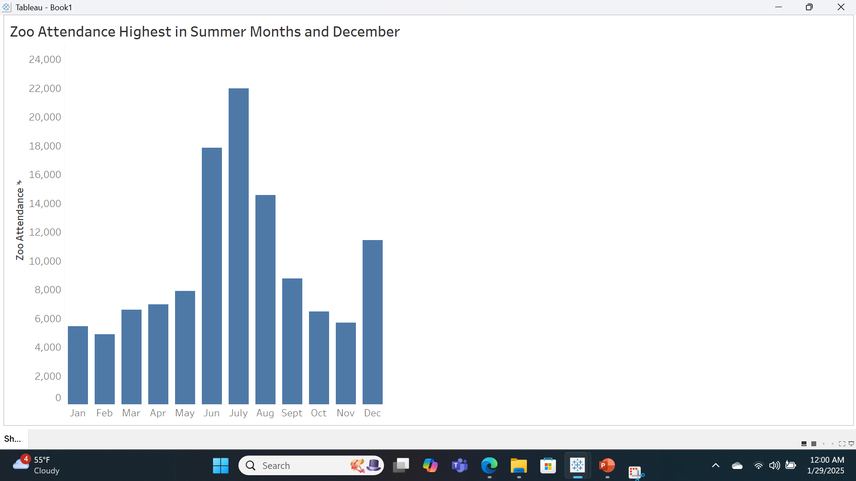
Column Chart Showing Zoo Attendance for each Month by TS.
Notes:
According to the chart, Zoo attendance is highest in July and generally high in the summer months, kids being home for summer break may be a contributing factor. We see a decline towards the end of the year and another surge in December, again, this may be due to kids being home for the winter break.

Slide 3
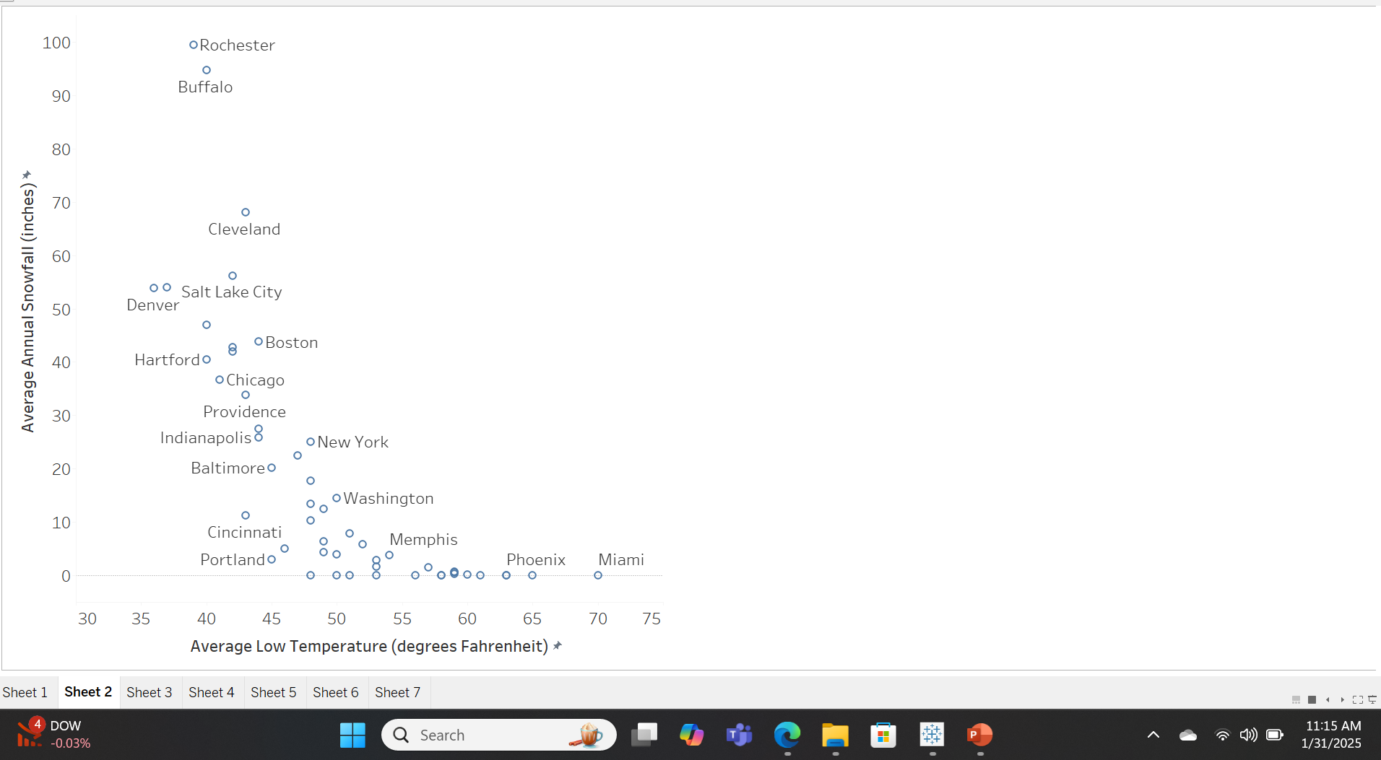
Scatter chart for average annual snowfall vs average low temperature by TS.
Notes:
The scatter plot shows us that there is a negative correlation between the average annual snowfall and the average low temperatures. Cities with high “average low temperature” have low amounts of average snowfall (examples are Miami and Phoenix), while cities with a low “average low temperature” have high average snowfall (examples are Rochester and Buffalo).

Slide 4
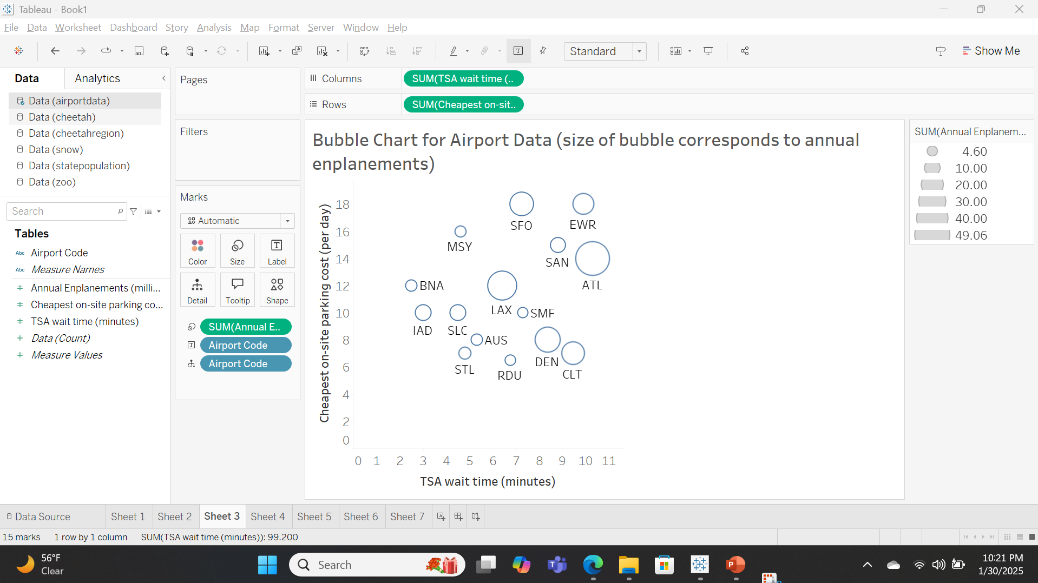
Bubble Chart for Airport Data on Annual Enplanements by TS.
Notes:
The size of each bubble chart reflects the number of annual enplanements for each airport, looking at the chart, we can see that ATL and LAX airports have the biggest bubbles showing that these two airports board the most passengers from our list of airports. The smallest bubbles like MSY, STL, and RDU show that they board the least number of passengers. There is no clear relationship between the three variables, but I noticed that airports with low parking costs and low TSA wait time board the least number of passengers.

Slide 5
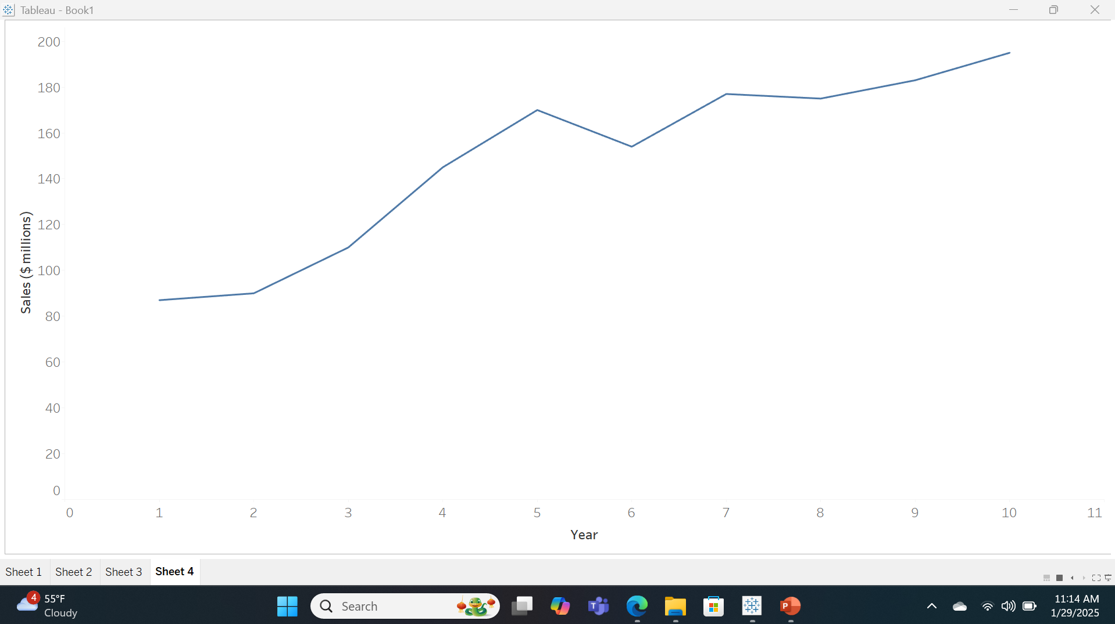
Line Chart Showing Sales of Cheetah Sports by TS.
Notes:
The line chart shows the sales of Cheetah Sports over a 10-year period. From the chart, we can see that there was a gradual rise in sales from year 1 to year 5, but there was a dip in year 6. Thankfully, Cheetah Sports recovered quickly from the dip and were in a relatively upwards progression from year 7 to year 10, making close to 200 million dollars by year 10.

Slide 6
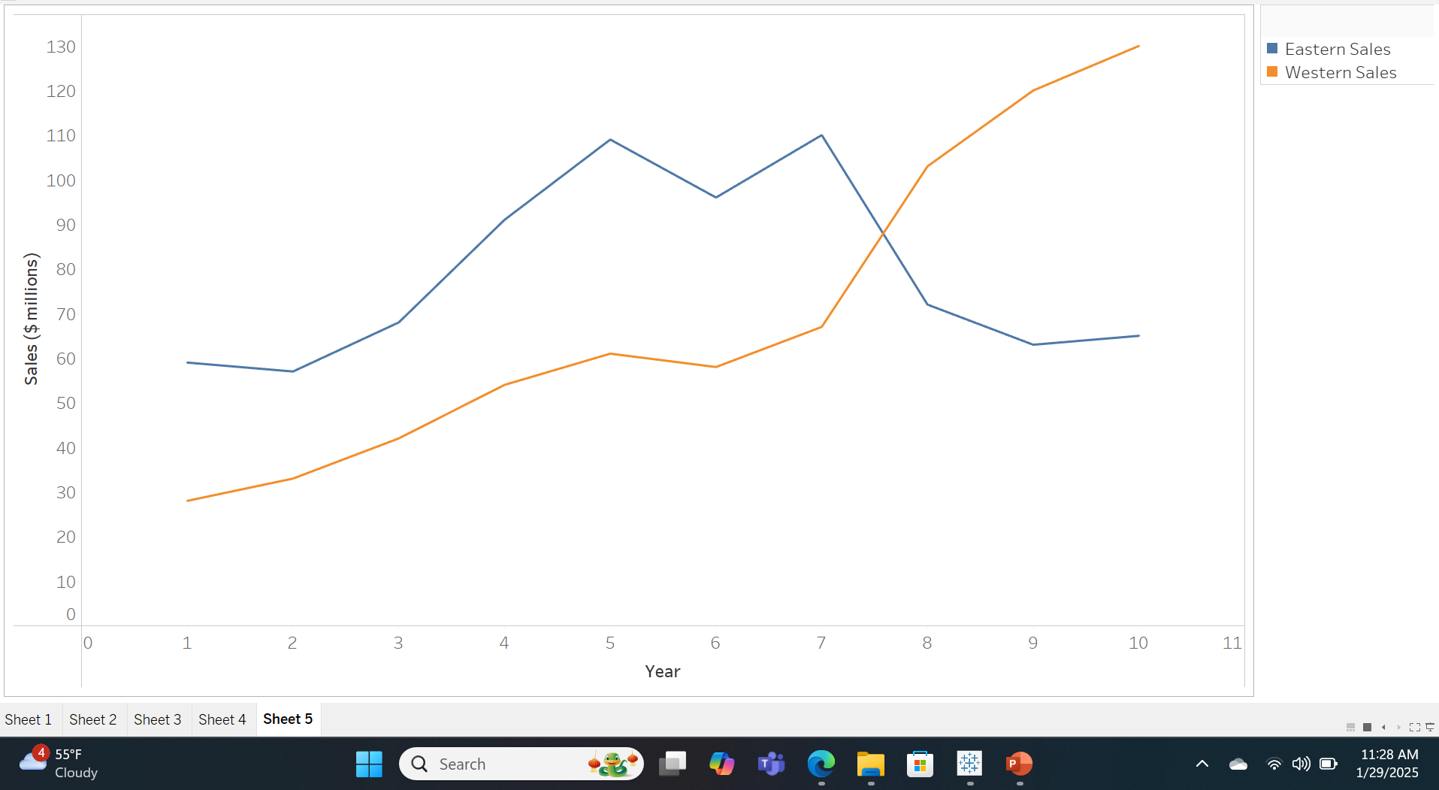
Line Chart Showing Sales of Cheetah Sports for Eastern & Western Regions by TS.
Notes:
The line chart shows the performance of the Eastern and Western regions sales over a 10-year period. The Western region sales started off lower/lesser than the Eastern region sales but overtook the Eastern region sales at around the year 8 mark. Also, the Eastern sales region started higher but suffered a significant dip between years 7 and 8.

Slide 7
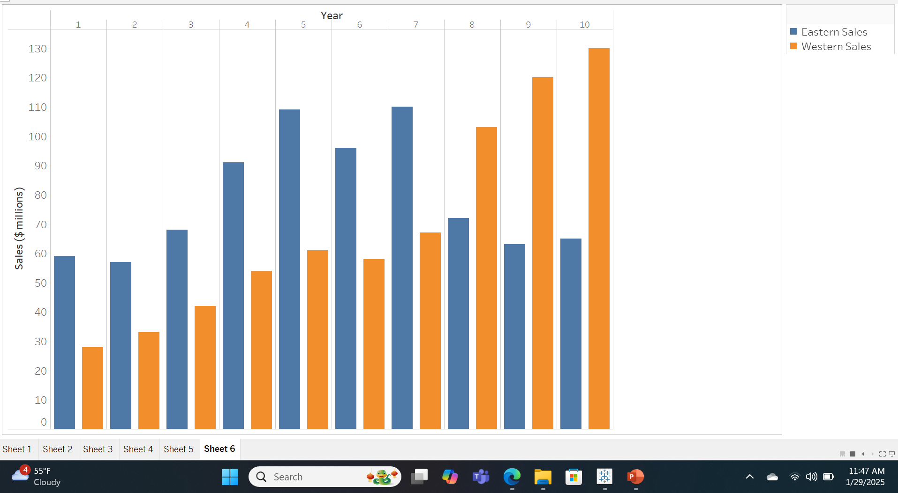
Comparison of Eastern and Western Sales using Clustered Column Chart by TS.
Notes:
The clustered column chart is also a perfect visualization to see how eastern and western region sales did over the 10-year period. From year 1 to year 7, the eastern region had more sales than the western region. However, from year 7 to year 10, the western region overtook the eastern region in sales. In year 10, the western region's sales were more than 120 million dollars, while its eastern counterpart made about half of that.

Slide 8
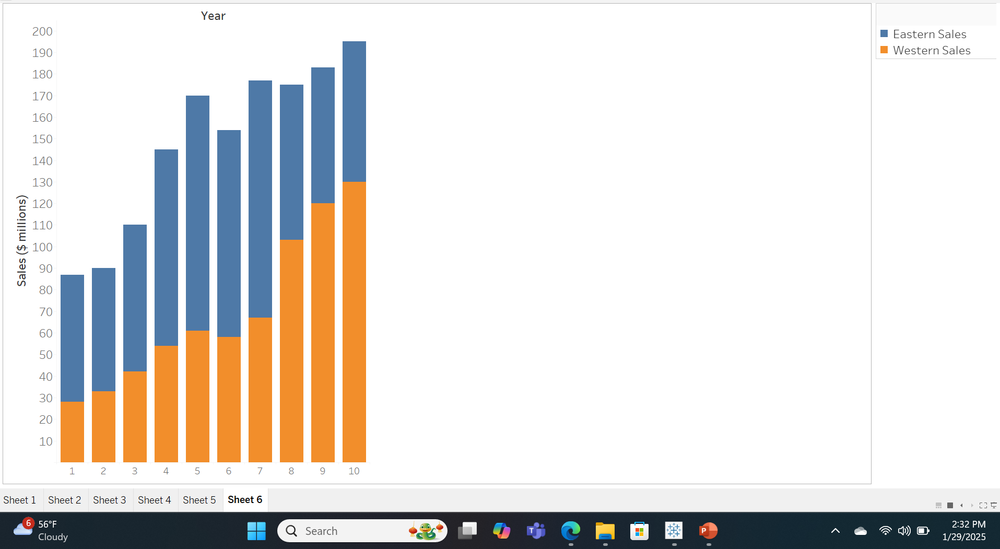
Stacked Column Chart showing Eastern and Western Sales by TS.
Notes:
The stacked column chart shows the Eastern and Western region sales as part of a whole. The overall sales increased over the 10-year period (except for the dip in year 6). At the start, Eastern region sales contributed to the sales more than the Western region sales did. However, by the end, the Western region sales overtook the Eastern sales, contributing more to the overall sales than the Eastern region.

Slide 9
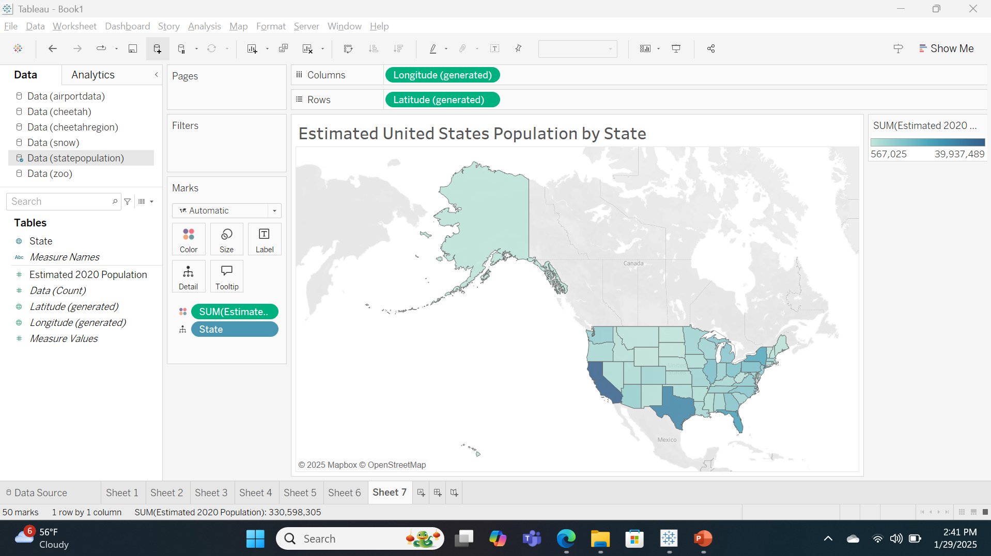
Choropleth Map showing population of the United States by TS.
Notes:
The choropleth map shows the distribution of the United States population across the 50 states for the year 2020. California has the highest population depicted by the dark shade, followed closely by Texas. Midwestern states are shown to have the least population, which is reflected in the light shading of the states.

